Slide 1
WEARABLE SAFEBAND FOR WOMEN
Prepared by:
GOKILA T
SUBHIKA S
PON PRIYA V
DIVYADHARSHINI S

Slide 2
PROBLEM STATEMENT
CURRENT SCENERIO
Beyond various precautions women harassment is increasing at an alarming rate.
No government measure could stop the harassment.
OUR PROPOSED SYSTEM
Our proposed system deals with the critical issues faced by women and will help them to solve the issue with technical support.
Adds a protection block for women’s safety in the existing system.
Its a user friendly device(wearable band that gives electric shock to the attacker).
The crime against the women can be reduce with the help of real time implementation of our system.

Slide 3
BLOCK DIAGRAM
RE
Rechargeable battery
Integration of multiple devices.
Affordable.
M
LCD
GSM
Vibration sensor
IO
MICRO
CONTROLLER
IOT Module
Neuro stimulator
Buzzer
g
GPS
Trigger

Slide 4
METHODOLOGY
Step 1: Start.
Step 2: Switch ON the 12 Volt power supply.
Step 3: Emergency button is pressed.
Step 4: If GPS receives signal, GPS will start calculating the current latitude and longitude values of the victim and send it as SMS to the registered mobile number using GSM module.
Step 5: If any vibrations detected by vibration sensor, get the last location from GPS and send to GSM module.
Step 6: IoT module tracks the last location of the victim and that location is updated in the Webpage.
Step 7: Neuro stimulator is turned ON, to apply shock to the attacker.
Step 8: Buzzer is turned ON to alert the people in the surrounding.

Slide 5
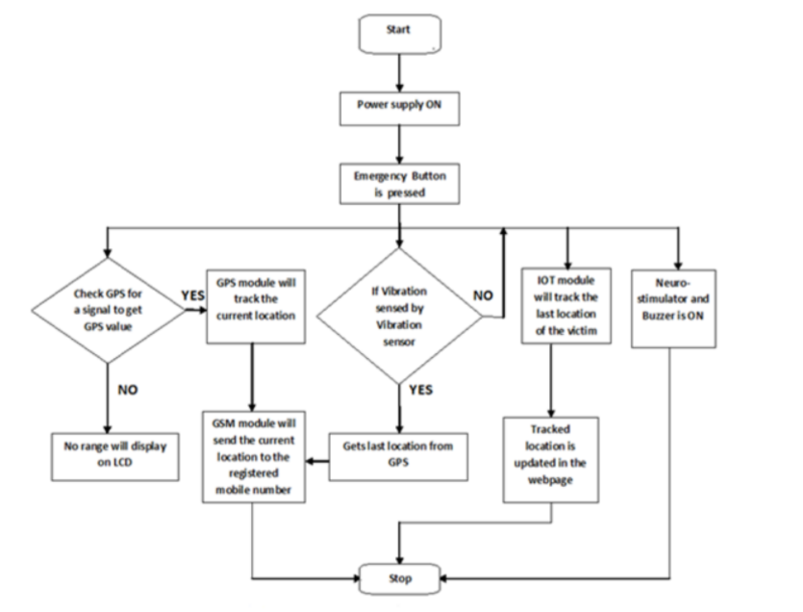
WORKFLOW

